Slide 1
Embedding layer
Decoding layers
Input Layer
(100 dim)
Hidden Layer
(100 dim)
Output
Layer (Based on action operators_num)
gat
.
.
.
.
.
Embedding
32 dim
256
h
y
Decoding
100 dim
LSTM
gat
sum
relu
2
6
operator
operator
operator
operator
operator
attention
Decoding
aggregate
Decoding
activate
Decoding
heads
Decoding
hidden_dim
Decoding
h1
h2
h3
h4
h5
h0
c0
LSTM
h1
c1
LSTM
h2
c2
LSTM
h3
c3
LSTM
h4
c4
LSTM
h5
c5
X0
Embedding
Embedding
Embedding
Embedding

Slide 2
Input Layer
(100 dim)
Hidden Layer
(100 dim)
Output
Layer (Based on action operators_num)
Embedding layer
Decoding layers
operator
“gat”
使用U（-0.1,0.1）初始化
.
.
.
.
.
Embedding
32 dim
y
h
Decoding
“256”
使用U（-0.1,0.1）初始化
100 dim
使用0初始化
bias
Layer1_Structure
“8”
Layer2_Structure
“gat”
“sum”
“relu”
“2”
“gcn”
“6”
operator
operator
operator
operator
operator
operator
operator
softmax
softmax
softmax
softmax
softmax
softmax
softmax
y1
y2
y3
y4
y5
y6
y10
attention
Decoding
aggregate
Decoding
activate
Decoding
heads
Decoding
hidden_dim
Decoding
attention
Decoding
hidden_dim
Decoding
h1
h2
h3
h4
h5
h6
h10
LSTM
h1
c1
LSTM
h2
c2
LSTM
h3
c3
LSTM
h4
c4
LSTM
h5
c5
LSTM
h6
c6
…
LSTM
h0
c0
y1
使用0初始化
X0
Embedding
Embedding
Embedding
Embedding
Embedding
Embedding

Slide 3
Search space
Attention | gat
 | gcn
 | cos
 | const
 | gat_sym
 | linear
 | generalized
Aggregate | sum
 | mean
 | max
 | mlp
Actiavte | sigmoid
 | tanh
 | relu
 | linear
 | softplus
 | Leaky_relu
 | relu6
 | elu
Heads | 1
 | 2
 | 4
 | 6
 | 8
 | 16
Hidden_units | 4
 | 8
 | 16
 | 32
 | 64
 | 128
 | 256
Notes:
Symbolizing an embedding

Slide 4
参数配置初始化
Controller训练
基于Controller选择GNN
基于历史child GNN选择
最佳GNN
Controller模型保存

Slide 5
Notes:
Note:
This is a simple round rectangle that can represent some process, operation, or transformation
Author: Elvis Saravia (ellfae@gmail.com)

Slide 6
Notes:
Note:
Can represent a neuron or some arbitrary operation
Author: Elvis Saravia (ellfae@gmail.com)

Slide 7




Softmax
Convolve
Sharpen
Notes:
Note:
These visuals could represent transformations (left) or operations (right)
The visuals on the right use the Math Equations Add on for Google Slides.
If you click on the equation you are able to modify it by:
Selecting Add Ons → Math Equations → Menu
While the equation is selected, click “Connect to Equation” on the “Math Equations UI”
Then change the properties like color, size, etc.
Author: Elvis Saravia (ellfae@gmail.com)

Slide 8




Softmax
Convolve
Sharpen
Notes:
Note:
These visuals could represent transformations (left) or operations (right)
The visuals on the right use the Math Equations Add on for Google Slides.
If you click on the equation you are able to modify it by:
Selecting Add Ons → Math Equations → Menu
While the equation is selected, click “Connect to Equation” on the “Math Equations UI”
Then change the properties like color, size, etc.
Author: Elvis Saravia (ellfae@gmail.com)
Log:
Added a dark theme version of the previous slide

Slide 9
Notes:
Note:
This can be used to represent a vector. If you want to edit the distance between each element, you can “ungroup” the shapes and then modify the distance between the individual lines.
Author: Elvis Saravia (ellfae@gmail.com)

Slide 10
Notes:
Note:
Can represent a multidimensional array (2D)
Author: Elvis Saravia (ellfae@gmail.com)

Slide 11
Notes:
Note:
These visuals can represent a multi-directional array (3D)
Author: Elvis Saravia (ellfae@gmail.com)

Slide 12
Architectures
Notes:
Note:
You can add abstract backgrounds here

Slide 13
Hidden Layers
Input Layer
a^{[1]}₁
a^{[2]}₁
a^{[3]}₁
Output Layer
a^{[1]}₂
a^{[2]}₂
a^{[3]}₂
a^{[4]}
Ŷ
X
a^{[1]}₃
a^{[2]}₃
a^{[3]}₃
a^{[1]}_{n}
a^{[2]}_{n}
a^{[3]}_{n}
X = A^{[0]}
A^{[1]}
A^{[2]}
A^{[3]}
A^{[4]}
Notes:
Created By @srvmshr
sourav@yahoo.com

Slide 14
Hidden Layers
Input Layer
^{[1}a]₁
a^{[2]}₁
a^{[3]}₁
Output Layer
a^{[1]}₂
a^{[2]}₂
a^{[3]}₂
a^{[4]}
Ŷ
X
a^{[1]}₃
a^{[2]}₃
a^{[3]}₃
a^{[1]}_{n}
a^{[2]}_{n}
a^{[3]}_{n}
X = A^{[0]}
A^{[1]}
A^{[2]}
A^{[3]}
A^{[4]}
Notes:
Created By @srvmshr
sourav@yahoo.com

Slide 15
Hidden Layers
Input Layer
a^{[1]}₁
a^{[2]}₁
a^{[3]}₁
Output Layer
a^{[1]}₂
a^{[2]}₂
a^{[3]}₂
a^{[4]}
Ŷ
X
a^{[1]}₃
a^{[2]}₃
a^{[3]}₃
a^{[1]}_{n}
a^{[2]}_{n}
a^{[3]}_{n}
X = A^{[0]}
A^{[4]}
A^{[1]}
A^{[2]}
A^{[3]}
Notes:
Original by @srvmshr
sourav@yahoo.com
Dark themed version by (Elvis Saravia - ellfae@gmail.com)

Slide 16
CONV operation
MxM
ReLU
+b1
+b1
MxMX2
+b2
+b2
NxNx3
MxM
ReLU
a^{[l-1]}
a^{[l]}
Notes:
Added by @srvmshr
Sourav @ yahoo.com

Slide 17
CONV operation
MxM
ReLU
+b1
+b1
MxMX2
+b2
+b2
NxNx3
MxM
ReLU
Notes:
Added by @srvmshr
Sourav @ yahoo.com

Slide 18
CONV operation
MxM
ReLU
+b1
+b1
MxMX2
+b2
+b2
NxNx3
MxM
ReLU
Notes:
Added by @srvmshr
Sourav @ yahoo.com

Slide 19
Striding in CONV
S=1
S=2
Notes:
Created by @srvmshr
Sourav @ yahoo.com

Slide 20
Inception Module
MaxPool Same s=1
5x5 Same
3x3 Same
NxNx192
1x1 Same
NxNx192
NxNx128
NxNx32
NxNx64
Notes:
Created by @srvmshr
Sourav @ yahoo.com

Slide 21
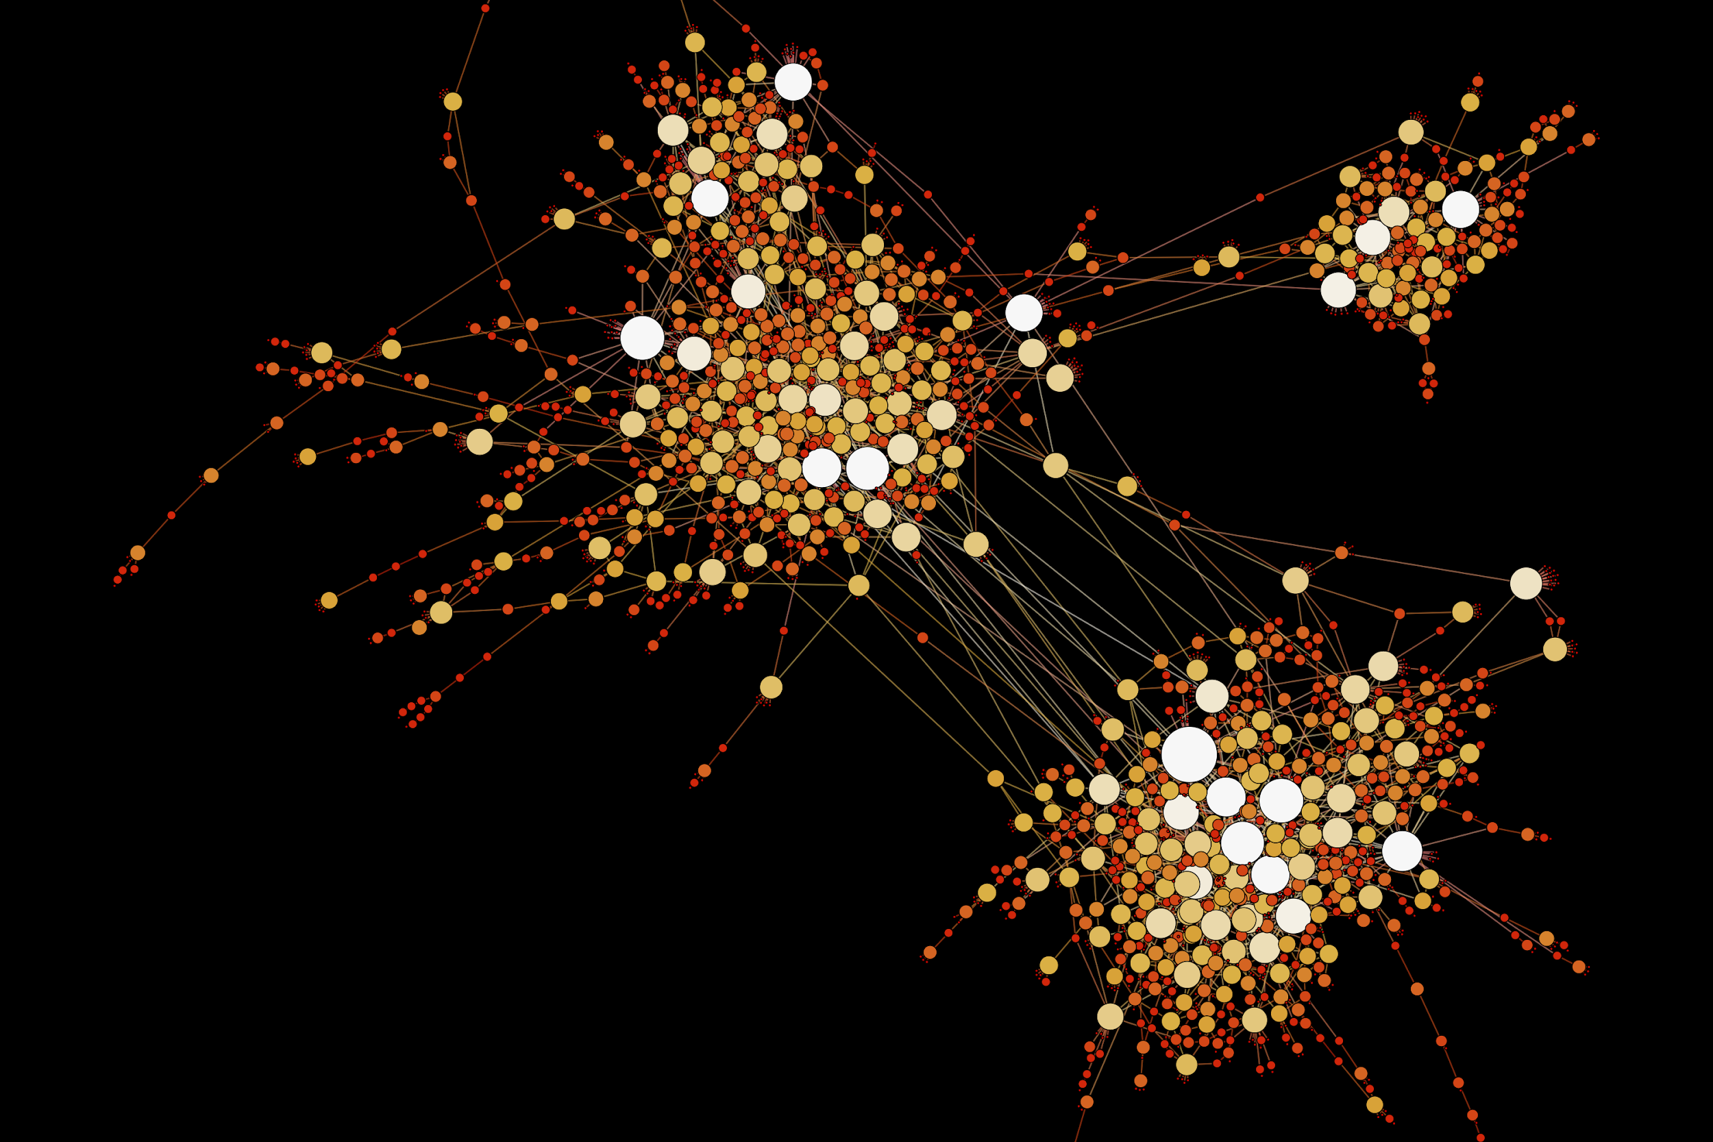
Notes:
Note:
This diagram could represent a simple logistic regression model; you can generalize to deep neural network by adding layers (see next slide)
Author: Elvis Saravia (ellfae@gmail.com)

Slide 22
Notes:
Note:
1 hidden layer neural network
Author: Elvis Saravia (ellfae@gmail.com)

Slide 23
Decoding layers
Embedding layer
Input Layer
(100 dim)
Hidden Layer
(100 dim)
Output
Layer (Based on action operators_num)
gat
.
.
.
.
.
Embedding
32 dim
256
h
y
Decoding
100 dim
LSTM
gat
sum
relu
2
6
operator
operator
operator
operator
operator
attention
Decoding
aggregate
Decoding
activate
Decoding
heads
Decoding
hidden_dim
Decoding
h1
h2
h3
h4
h5
h0
c0
LSTM
h1
c1
LSTM
h2
c2
LSTM
h3
c3
LSTM
h4
c4
LSTM
h5
c5
Embedding
Embedding
Embedding
Embedding
Embedding
X0

Slide 24
Input Layer
(100 dim)
Hidden Layer
(100 dim)
Output
Layer (Based on action operators_num)
h
y
gat
sum
relu
2
6
operator
operator
operator
operator
operator
attention
Decoding
aggregate
Decoding
activate
Decoding
heads
Decoding
hidden_dim
Decoding
h1
h2
h3
h4
h5
h0
c0
LSTM
h1
c1
LSTM
h2
c2
LSTM
h3
c3
LSTM
h4
c4
LSTM
h5
c5
Embedding
Embedding
Embedding
Embedding
Embedding
X0
3x3 conv
3x3 conv
3x3 conv
add
add
add
3x3 conv
3x3 conv
5x5 conv
3x3 avg
LSTM
LSTM
LSTM
LSTM
Embedding
Embedding
Embedding
Embedding

Slide 25
Softmax
Linear
Add & Norm
Feed
Forward
Add & Norm
Add & Norm
Multi-Head
Attention
Feed
Forward
Add & Norm
Add & Norm
Masked
Multi-Head
Attention
Multi-Head
Attention
Positional
Encoding
Positional
Encoding
Input
Embedding
Output
Embedding
Inputs
Outputs (shifted right)
Notes:
Note:
Using the same visual components from before and a few new custom ones, I was able to come up with the Transformer architecture
This is a reproduction of the Transformer architecture figure presented in the work of Vaswani et al. 2017
You can further customize it however you want
Author: Elvis Saravia (ellfae@gmail.com)

Slide 26
Softmax
Linear
Add & Norm
Feed
Forward
Add & Norm
Add & Norm
Multi-Head
Attention
Feed
Forward
Add & Norm
Add & Norm
Masked
Multi-Head
Attention
Multi-Head
Attention
Positional
Encoding
Positional
Encoding
Input
Embedding
Output
Embedding
Inputs
Outputs (shifted right)
Notes:
Note:
Using the same visual components from before and a few new custom ones, I was able to come up with the Transformer architecture
This is a reproduction of the Transformer architecture figure presented in the work of Vaswani et al. 2017
You can further customize it however you want
Author: Elvis Saravia (ellfae@gmail.com)

Slide 27
I
love
coding
and
writing
Tokenize
“I love coding and writing”
Notes:
Note:
This figure aims to demonstrate the process of tokenization
If you want to change the gradient colors of this shape, you can simply click on the shape and then select “Fill color” (the bucket looking icon at the top).
This is a gradient color so you can customize however you want
Author: Elvis Saravia (ellfae@gmail.com)

Slide 28
ML Concepts
Notes:
Note:
Gradient background shows some inspirations and ideas for color themes that could be used for backgrounds
The examples used in this section are inspired by https://uigradients.com

Slide 29
Size
Family?
X
Y
#bed
Walk?
PRICE ŷ
Basic Neuron Model
ZIP
School
How does NN work (Insprired from Coursera)
Wealth
Ŷ = 0
X
Logistic Regression
Ŷ = 1
Notes:
By @srvmshr
sourav@yahoo.com

Slide 30
Linear regression
ReLU(x)
$
$
Size
Size
Notes:
By @srvmshr
sourav@yahoo.com

Slide 31
256
225
56
.
.
.
214
210
211
NxN
NxN
NxN
NxN
R-G-B
Unrolling Feature vectors
Notes:
By @srvmshr
sourav@yahoo.com

Slide 32
Large NN
Med NN
η
Small NN
SVM,LR etc
Amount of Data
Why does Deep learning work?
Notes:
By @srvmshr
sourav@yahoo.com

Slide 33
Hidden
Input
Output
a^{[1]}₁
a^{[1]}₂
One hidden layer neural network
X
a^{[2]}
Ŷ
a^{[1]}₃
a^{[1]}₄
X = A^{[0]}
A^{[1]}
A^{[2]}
Notes:
By @srvmshr
sourav@yahoo.com

Slide 34
a^{[1]}₁
x_{[1]}
a^{[2]}
a^{[1]}₂
x_{[2]}
x_{[1]}
x_{[2]}
x_{[3]}
Neural network templates
Notes:
By @srvmshr
sourav@yahoo.com

Slide 35
Train
Valid
Test
Underfitting
Good fit
Overfitting
x2
x2
x2
x1
x1
x1
Train-Dev-Test vs. Model fitting
Notes:
By @srvmshr
sourav@yahoo.com

Slide 36
x_{[1]}
x_{[2]}
a_{[L]}
DropOut
x_{[3]}
x2
r=1
x2
Normalization
x1
x1
Notes:
By @srvmshr
sourav@yahoo.com

Slide 37
J
w2
Early stopping
Err
w1
w1
w2
Before Normalization
Dev
Train
it.
J
w2
w1
w1
After Normalization
w2
Notes:
By @srvmshr
sourav@yahoo.com

Slide 38
x₁
x₂
w[L]
w[1]
w[2]
w[L-2]
w[L-1]
Deep neural networks
FN
TN
TP
FP
Understanding
Precision & Recall
Notes:
By @srvmshr
sourav@yahoo.com

Slide 39
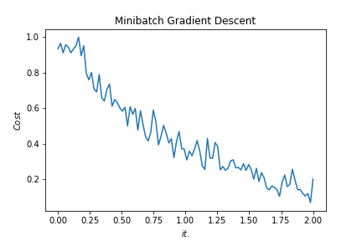
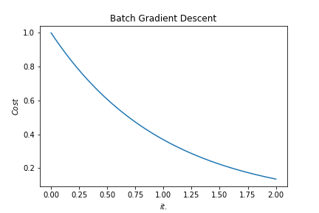
Batch vs. Mini-batch Gradient Descent
w2
w2
BGD
SGD
Batch Gradient Descent vs. SGD
SGD
w1
w1
Notes:
By @srvmshr
sourav@yahoo.com

Slide 40
x_{[1]}
p_{[1]}
x_{[2]}
p_{[2]}
x_{[3]}
Softmax Prediction with 2 outputs
Notes:
By @srvmshr
sourav@yahoo.com

Slide 41
Abstract backgrounds
Notes:
Note:
You can add abstract backgrounds here

Slide 42
Notes:
Note:
You can change the gradient of each component
Author: Elvis Saravia

Slide 43
dair.ai
Notes:
Note:
This is the header I use for the dair.ai NLP Newsletter
You can change the gradient of each component
You can customize the background as well by right clicking and changing to another gradient or static color
Author: Elvis Saravia

Slide 44
Notes:
Note:
This is the header I use for the dair.ai NLP Newsletter
You can change the gradient of each component
Author: Elvis Saravia

Slide 45
Notes:
Note:
This is the header I use for the dair.ai NLP Newsletter
You can change the gradient of each component
Author: Elvis Saravia

Slide 46
Gradient Backgrounds
Notes:
Note:
Gradient background shows some inspirations and ideas for color themes that could be used for backgrounds
The examples used in this section are inspired by https://uigradients.com

Slide 50
Other examples

Slide 51
3
16+32
16
16
16
16
1
Convolution 3x3
Convolution 1x1
Dropout 0.1
Max Pooling 2x2
Skip connection
Dropout 0.2
Up Sampling 2x2
Block copied
Dropout 0.3
32
32
32+64
32
64
64
64+128
64
128
128
128+256
128
256
256
Notes:
By @avsthiago

Slide 52
Input:
(None, size, size, 3)
InputLayer
Output:
(None, size, size, 3)
Inception-v3 architecture
Input:
(None, 14, 14, 2048)
GlobalAveragePooling2D
Output:
(None, 2048)
Input:
(None, 2048)
Dense
Activation
ReLU
Output:
(None, 1024)
Input:
(None, 1024)
Dense
Activation
Softmax
Output:
(None, 7)
Notes:
By @avsthiago

Slide 53
Layer1
Layer2
Layer3
Layer4
Input
Conv
Max-Pool
Conv
Max-Pool
FC
FC
Softmax
Layer1
Layer2
Layer3
Layer4
Layer5
Layer6
Layer7
Layer8
Input
Conv
Max-Pool
Conv
Max-Pool
Conv
Conv
Conv
Max-Pool
FC
FC
FC
Softmax
Notes:
By @avsthiago

Slide 54
Filter concatenation
3x3 convolutions
5x5 convolutions
1x1 convolutions
1x1 convolutions
1x1 convolutions
1x1 convolutions
3x3 max pooling
Previous layer
Notes:
By @avsthiago

Slide 55
Filter concatenation
3x3 convolutions
5x5 convolutions
1x1 convolutions
1x1 convolutions
1x1 convolutions
1x1 convolutions
3x3 max pooling
Previous layer
Notes:
By @avsthiago

Slide 56
Output
FC
FC
1x7 conv
1x7 conv
Inception 2
Inception 2
Inception 2
Inception 1
1x11 conv
1x11 conv
Input

Slide 57
Previous layer
1x3 conv,
1 padding
1x3 conv,
1 padding
1x7 conv,
3 padding
1x3 conv,
1 padding
1x5 conv,
2 padding
1x3 conv,
1 padding
Filter concatenation

Slide 58
Avg-Pool
Auxiliary Classifier
Conv
FC
FC
Softmax
Inception
Input
Inception
Conv
Max-Pool
Conv
Max-Pool
Conv
Max-Pool
Inception
Inception
Max-Pool
Inception
Inception
Inception
Inception
Inception
Max-Pool
Avg-Pool
Conv
FC
Softmax
Avg-Pool
Auxiliary Classifier
Conv
FC
FC
Softmax
Notes:
By @avsthiago

Slide 59
Filter concatenation
Filter concatenation
3x3 conv.
1x3 conv.
3x1 conv.
1x1 conv.
3x3 conv.
3x3 conv.
1x1 conv.
1x3 conv.
3x1 conv.
3x3 conv.
1x1 conv.
1x1 conv.
Pool
1x1 conv.
1x1 conv.
Pool
1x1 conv.
1x1 conv.
Previous layer
Previous layer
(a)
(b)
Notes:
By @avsthiago

Slide 60
Previous input
Previous input
x
x
F(x)
F(x)
Stacked layers
Stacked layers
x
identity
+
y=F(x)
y=F(x)+x
R1
R1
R2
R1
R1
R2
R3
R1
R2
R3
Notes:
By @avsthiago

Slide 61
Dense Block 1
Dense Block 2
Dense Block 3
Softmax
FC
Avg-Pool
Avg-Pool
Conv
Conv
Input
Avg-Pool
Conv
Transition layers
Notes:
By @avsthiago

Slide 62
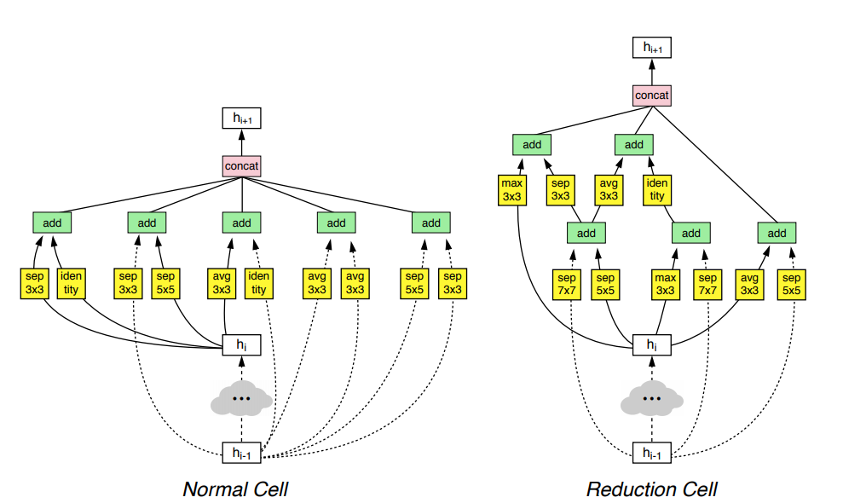
h_{i+1}
Filter concatenation
h_{i+1}
add
add
Filter concatenation
3x3 max
3x3 conv
3x3 avg
identity
add
add
add
add
add
add
add
add
3x3 conv
identity
3x3 conv
5x5 conv
3x3 avg
identity
3x3 avg
3x3 avg
3x3 conv
5x5 conv
7x7 conv
5x5 conv
3x3 max
7x7 conv
3x3 avg
5x5 conv
h_{i}
h_{i}
...
...
h_{i-1}
h_{i-1}
(a)
(b)
Notes:
By @avsthiago

Slide 63
Notes:
By @avsthiago

Slide 64
Notes:
By @avsthiago
Dark-theme version of the previous (by Elvis Saravia)

Slide 65
Max(1,1,5,6) = 6
Y
1
1
2
4
5
6
7
8
6
8
3
2
1
0
Pooling performed with a 2x2 kernel and a stride of 2
3
4
1
2
3
4
X
Image Representation
Notes:
By @avsthiago

Slide 66
Advantages | Disadvantages
only one process enters the critical section at a time, and the system can achieve mutual exclusion | the algorithm has low fault-tolerance
tokens are passed in a fair circle, and any node will get the chance to enter the critical zone without starvation | token loss detection is more difficult
the number of messages sent by the token once in the system is at most N-1 | in the physical ring, when a token joins or exits, the network structure needs to be reconfigured, which is more complicated
the algorithm is simple in principle and easy to implement | during the reconfiguration process, no node in the system can access the critical section, which is expensive

